Slide 1
Outline
GPU computing & CUDA
What is a GPU
What are GPUs for
Why you need them for scientific computing
Machine Learning (ML) and Convolutional Neural Networks (CNNs)
Machine learning esp. classification
Neural networks and CNNs
Imaging FlowCytobot (IFCB) convolutional neural network result
What is IFCB and what data does it produce
Recent experiments comparing CNNs with traditional ML
Preliminary performance results and future research directions

Slide 2
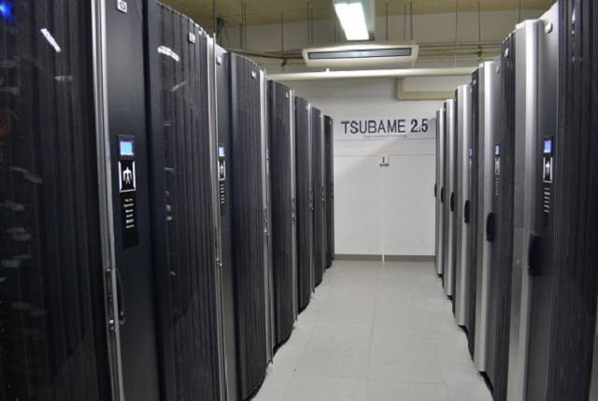
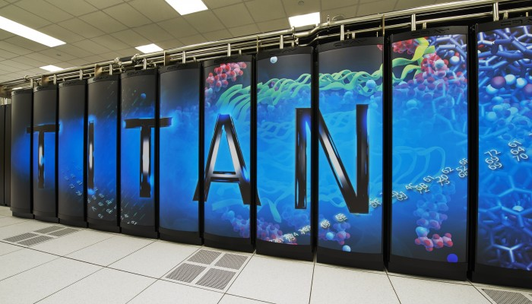
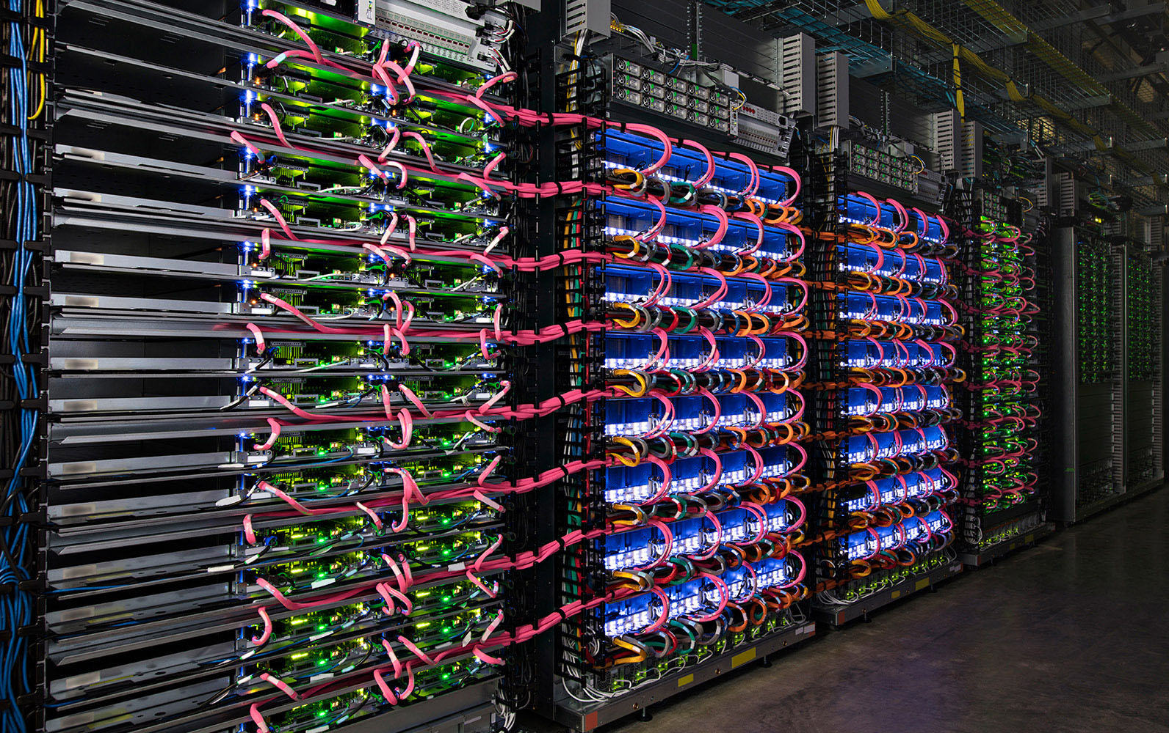
HPC: Big huge ultra mega super computers
Commercial
Academic
Government

Slide 3
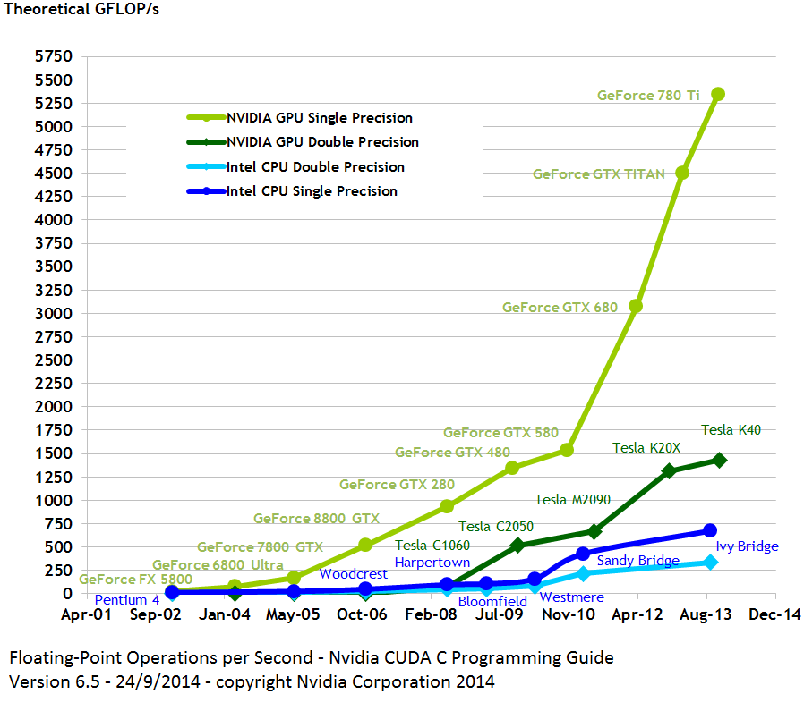
GPUs help make them possible
Massively parallel
Hundreds of cores, which means thousands of threads processed at once
Cheap
Highly available
Programmable: CUDA

Slide 4
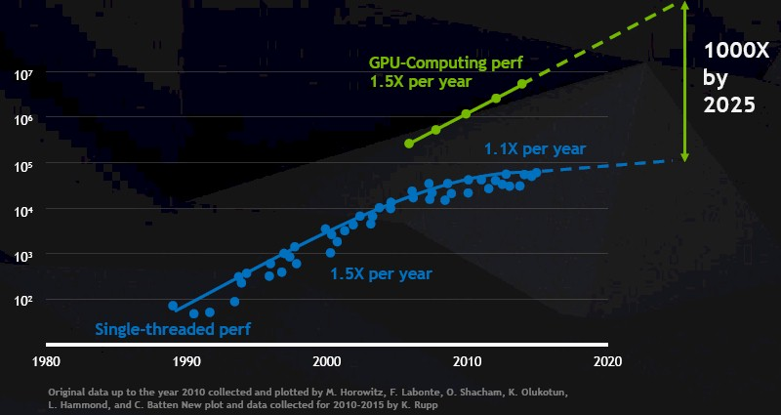
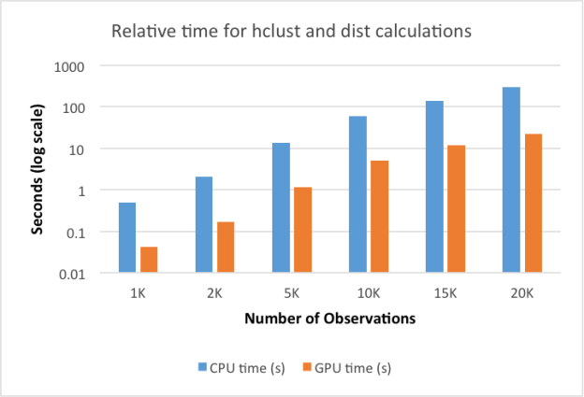
Why you want to use this now
Speed benefits
CPU uni-processor (core) speed is not doubling every 2 years anymore!
You get more cores on a CPU for more parallelism, but not compute speed
GPU core units (apu) compute speed is doubling every 18 months!
Certain kinds of computing are not thermally or economically possible with CPUs any more
Scaling benefits
Datasets from long-term projects grow as more data is added from experiments and field recordings
The larger your data set, more processing power is needed to get faster and more detailed analysis
http://blog.revolutionanalytics.com/2015/06/computing-with-gpus-in-r.html
Y axis is actually transistors, no idea why Huang calls it perf
Notes:
tested the rpud package for hierarchcal clustering, which involves calculating a distance matrix. Here's a comparison of the perfomance using regular R functions (blue) and with GPU-accelerated functions (orange)

Slide 5
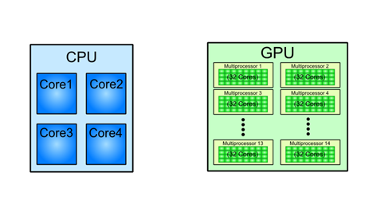
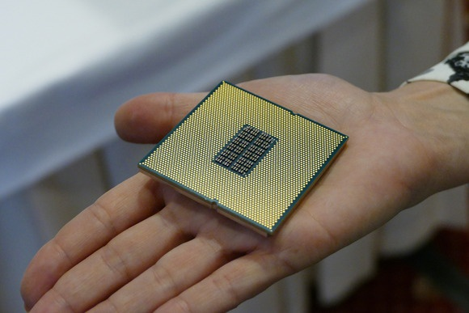
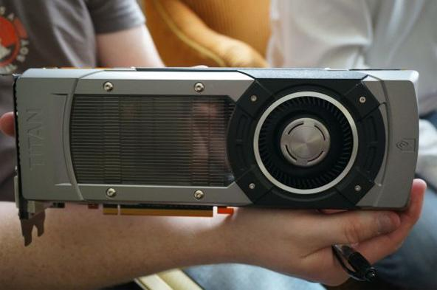
GPU: Graphics Processing Unit
Most computers have one.
Most consumer CPUs have a GPU built into the die (to increase MSRP)
Dedicated cards usually take up a specialized interface slot (PCIE)
CPUs are composed of just few cores with lots of cache memory that can handle a few software threads at a time.
GPU are composed of hundreds of cores that can handle thousands of threads simultaneously.

Slide 6
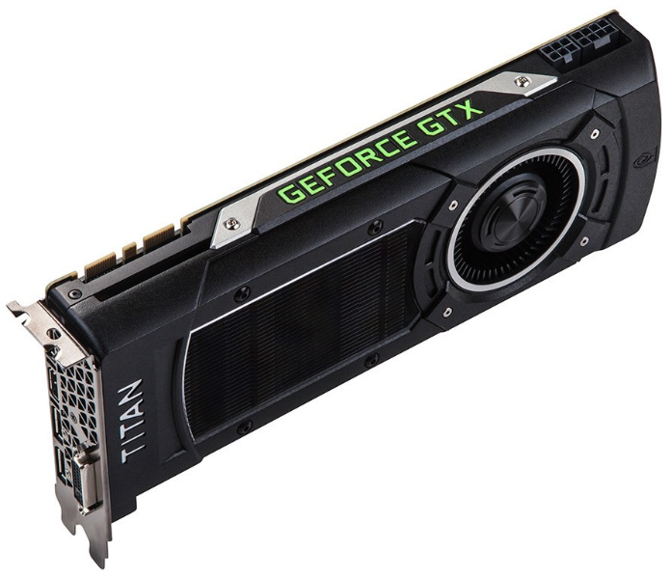
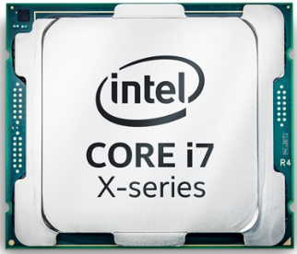
Do you need a GPU or a CPU?
Low latency,
Reasonable throughput
High Throughput,
Reasonable latency
Compute many simple jobs within a reasonable timescale.
Compute a single precise job soon as possible
Examples: graphics and multimedia, signal processing, bitcoin
Examples: virtualization and emulation, running OS,

Slide 7
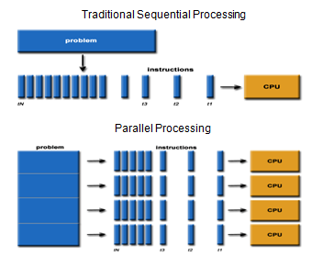
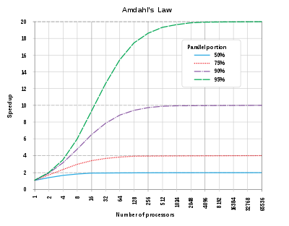
Can you really get 100x speedup?
It depends on the non-parallel part: Amdahl’s law.
Signiﬁcance: An accelerated program is going to be as fast as its serial part!
Complex application normally make use of many algorithms.
Parallel programming breaks the problem into discrete parts that are run concurrently
Problem can be solved in less time with multiple compute resources instead of just one
Huge speedup

Slide 8
How can I make my code faster?
Analyze algorithm for exposing parallelism
Block size
Number of threads
Tool: pen, paper, chalk/whiteboard, vim/nano
Machine and library dependency
Libraries change frequently and only work on certain OSs and GPUs
Compilers need to be regenerated to take advantage of the hardware
Optimize application for maximum throughput
Global data set (Have efficient data transfers)
Local data set (Limited on-chip memory)
Register space (Limited on-chip memory)
Tool: Occupancy calculator, coffee
IS has the resources to develop and enhance applications to use GPU and CUDA

Slide 9
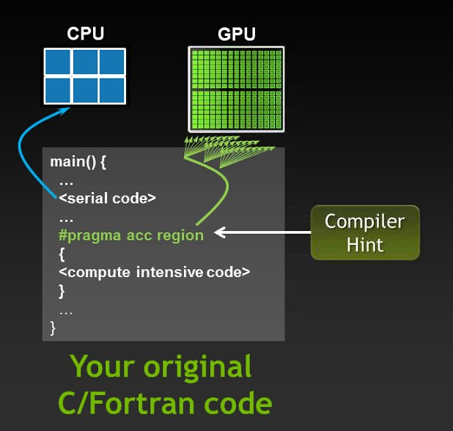
CUDA: COMPUTE UNIFIED DEVICE ARCHITECTURE
Introduced by Nvidia in late 2006.
CUDA is a compiler and toolkit for programming NVIDIA GPUs.
CUDA API extends the C programming language.
It is a scalable model.
Abstraction from hardware: you don’t see every little aspect of the machine
Objectives:
Express parallelism.
Give a high level abstraction from hardware.
Notes:
•Abstracting from the hardware
•Abstraction by the CUDA API. You don’t see every little aspect of the machine.
•Gives flexibility to the vendor. Change hardware but keep legacy code.

Slide 10
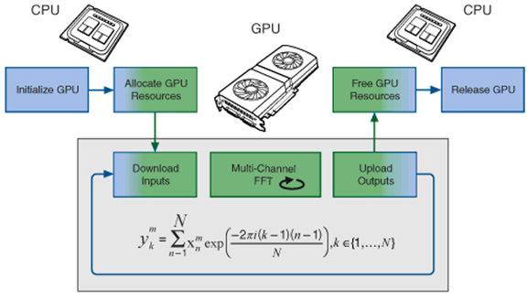
How does it compare to normal computing?
CUDA has full support C/C++ (and much more.)
Code runs as if it was done on a CPU
Example: Running a Fast Fourier Transform algorithm on a GPU

Slide 11
GPU Common Uses
Physical based simulation and physics engines (usually based on Newtonian physics models)
Conway's Game of Life, cloth simulation, fluid incompressible flow by solution of Euler equations (fluid dynamics)
Navier–Stokes equations
Statistical physics
Lattice gauge theory
Segmentation – 2D and 3D
Level set methods
CT reconstruction
Fast Fourier transform
GPU learning – machine learning and data mining computations
k-nearest neighbor algorithm
Fuzzy logic
Tone mapping
Audio signal processing
Speech processing
Digital image processing
Video processing
Hardware accelerated video decoding and post-processing
Hardware accelerated video encoding and pre-processing
Global illumination – ray tracing, photon mapping, radiosity among others, subsurface scattering
Geometric computing – constructive solid geometry, distance fields, collision detection, transparency computation, shadow generation
Monte Carlo simulation of light propagation
Weather forecasting
Climate research
Molecular modeling on GPU
Quantum mechanical physics
Astrophysics
Bioinformatics
Computational finance
Medical imaging
Clinical decision support system (CDSS) [Watson]
Computer vision
Digital signal processing / signal processing
Control engineering
Operations research
Neural networks
Database operations
Lattice Boltzmann methods
Cryptography and cryptanalysis
Password cracking
Cryptocurrency transactions processing ("mining") (Bitcoin mining)
Cryptocurrency (e.g., Bitcoin mining)
Video gaming including rendering, physics simulation
Personal assistants e.g., Alexa, Siri
Machine translation and speech-to-text
Self driving cars and driver assist (e.g., lane crossing detection)
UI such as gesture recognition from accelerometers and cameras
Object identification in images including face recognition
Weather forecasting and climate modeling
Digital signal processing (DSP)

Slide 12
Examples: cryptography, science
Password cracking with Hashcat:
“World's fastest password cracker”
made its way into the news many times for the optimizations and flaws discovered by its creator, which were exploited in subsequent Hashcat releases.
Science example from WHOI:
880m plankton images taken since 2006 by Imaging FlowCytobot
Traditional machine learning has been used to automate image classification
What happened when we investigated switching from traditional machine learning to deep learning
Stay tuned to see the amazing foray into deep learning…

Slide 13
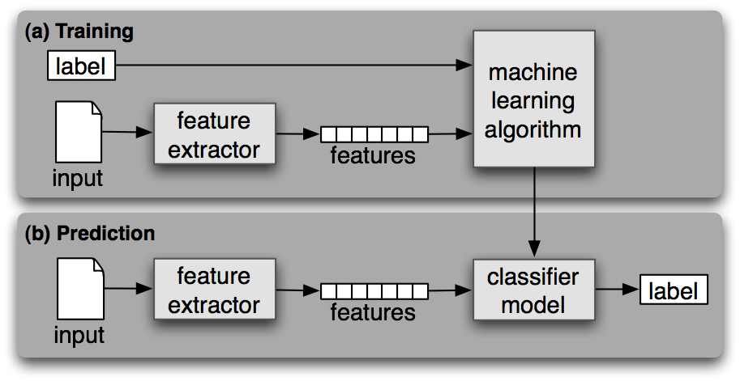
Machine learning: traditional classification approach (CPU)
Notes:
Feature extraction requires writing code to generate features from input data (esp. for dense data such as images)

Slide 14
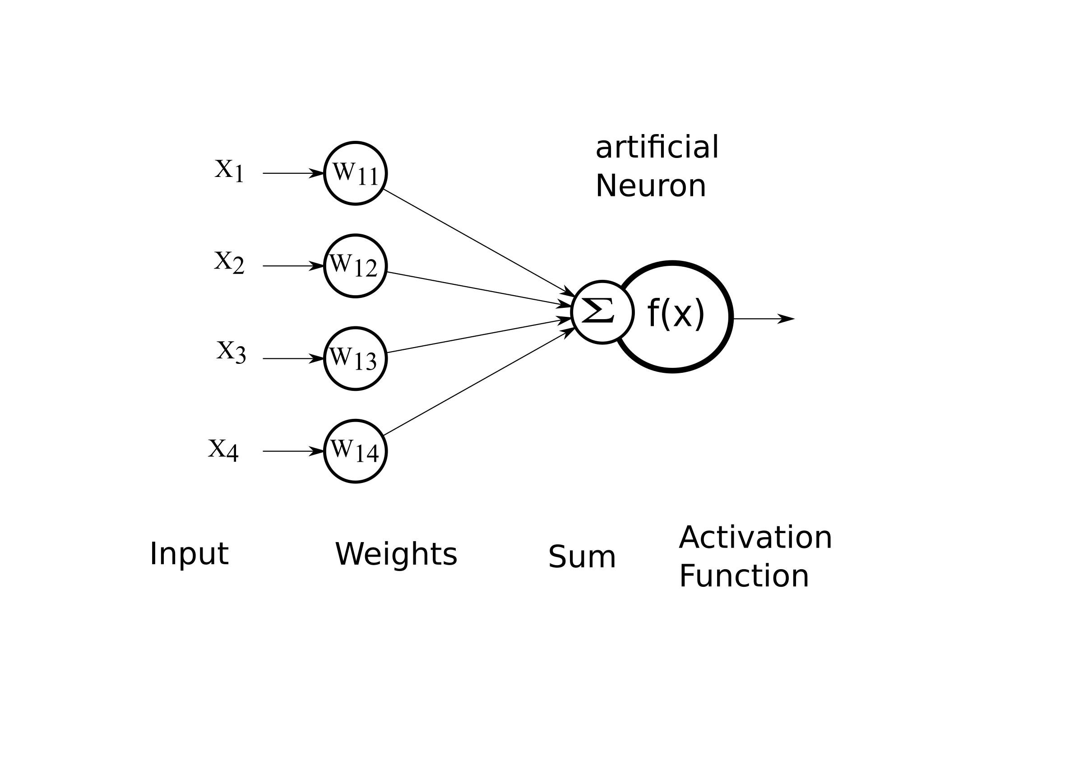
Artificial Neural Network (ANN)
What are neurons?
How are they connected?
Neuron → A number
Array → A set of numbers
Network → series of weights that changes the value of the neuron
Notes:
Training = backpropagation and optimization of loss

Slide 15
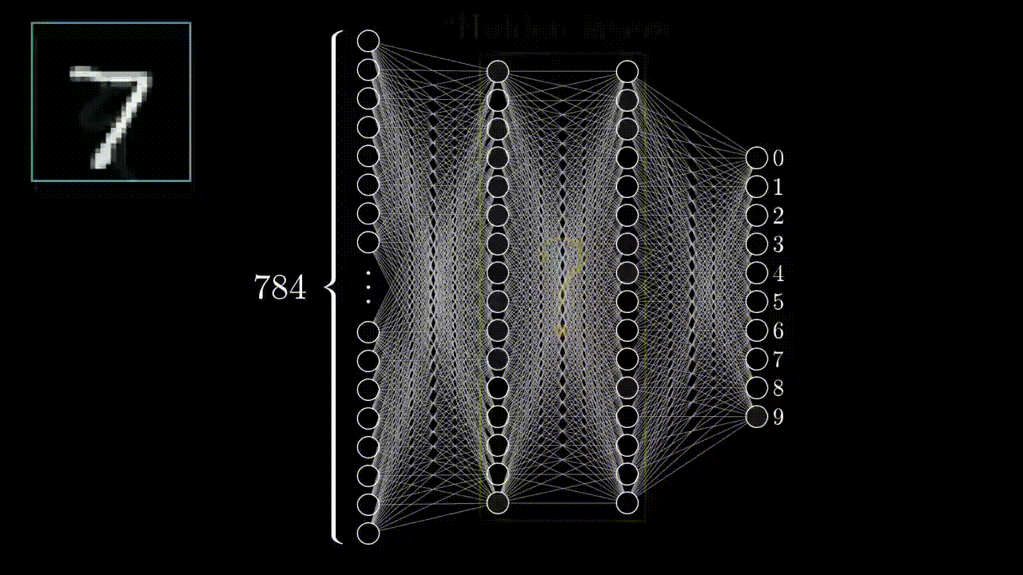

Neural network in action: digit classification
Animation by http://www.3blue1brown.com/
Output layer
Hidden layers
Input Layer
Notes:
In artificial neural networks, the input is also a vector where each dimension is mapped to one neuron in the input layer. A neuron in the next layer is “activated” based on a weighted sum of the values of all the neurons in the previous layer passed through an activation function (traditionally a sigmoid function). The process is repeated for subsequent layers. Weights are initially random. During training, weights are iteratively adjusted to minimize a loss function which is computed over the output layer based on how well the output matches the desired output for the given input. Weights eventually converge to stable values and training is complete. After training, putting a vector into the input layer and computing the resulting activations results in an output layer that approximates the correct result.
The number of layers, their sizes, and the connectivity between them (typically fully-connected) constitute the architecture of the network. Architectures with more than one hidden layer are common.

Slide 16


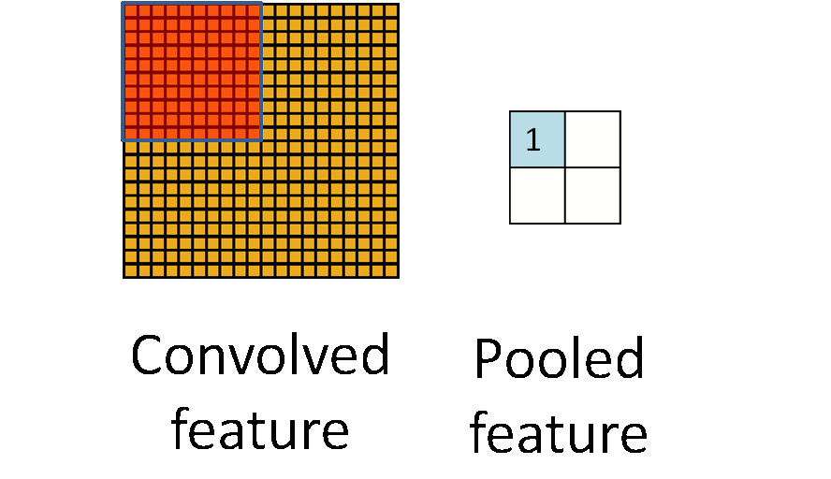
Deep learning: Convolutional Neural Networks (CNNs)
source: code.flickr.com
Convolution: feature extraction by kernel mask
Pooling: down-sampling by average or max value
Animation by Erik Reppel
https://hackernoon.com/visualizing-parts-of-convolutional-neural-networks-using-keras-and-cats-5cc01b214e59
Notes:
In contrast to traditional image recognition approaches, CNNs learn feature extraction during training, eliminating feature engineering.
Each convolution layer computes features of each small region of the image and pools them into a set of smaller feature maps which are used as inputs to the next convolutional layer. The feature maps are then "flattened" into high dimensional vectors and classified using many fully-connected layers and a final classification layer.
The key is that each convolution is “filtered” by a kernel mask which multiplies the value over each pass (shift) of the filter. This filter can detect specific features, by multiplying the values in such a way that features of intrests (like curves, or sharp edges) get a higher value for each shift so specfic regions have greater values if a feature is present. Pooling shrinks this down into a one dimentional feature for passing into the connected layers.
During training, the algorithm optimizes the weights of its convolutional filters, hence learning the filters shape themselves, to minimize the error at the end of training.
CNN architecture differs from other neural network approaches in the use of convolutional layers and in the large number of fully-connected layers.

Slide 17
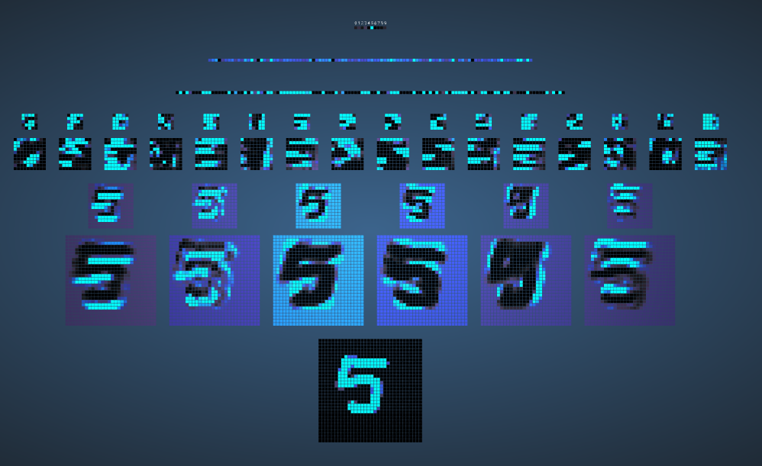
CNN in action: digit classification
Notes:
By taping hundreds of thousands of neurons, all with simple weights and activation functions. The computational cost of running this far outstrips CPU capacity which requires one core or thread to each activation of each neuron
Because the activation function can be very simple, a GPU properly coded can compute a pass of the entire network in less time because the cores are 10-20x more numerous than a cpu

Slide 18
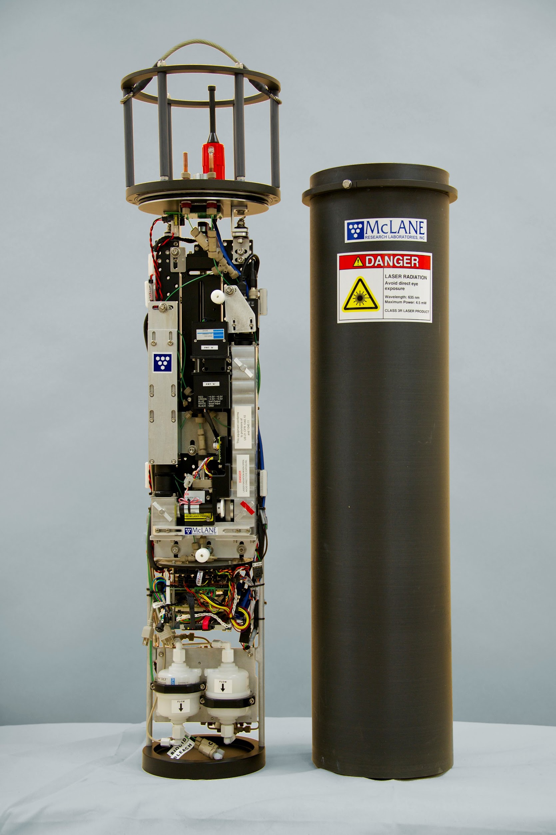
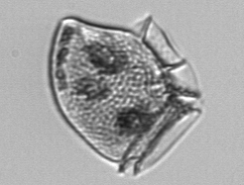
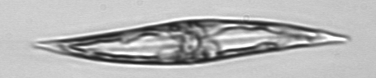
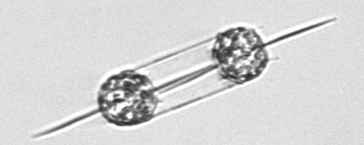
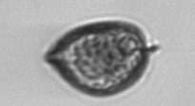
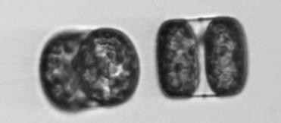
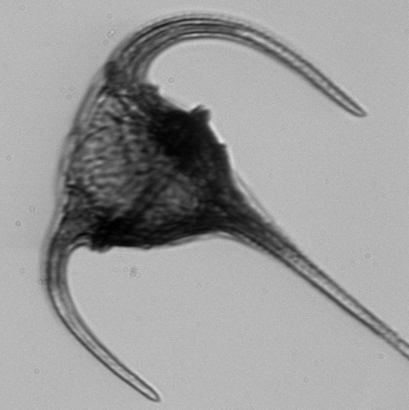
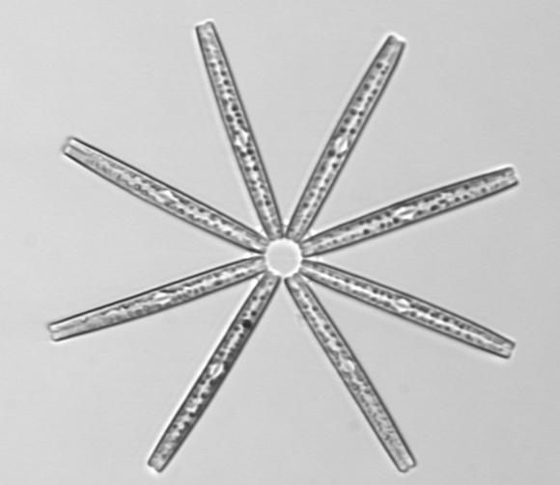
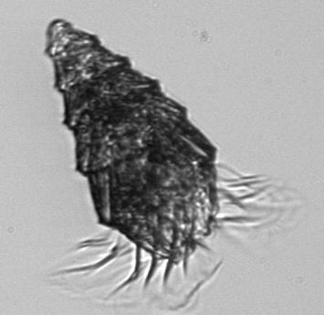
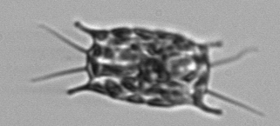
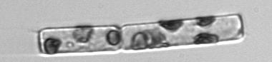
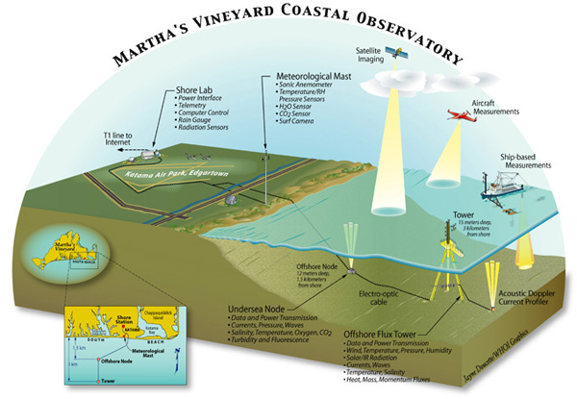
Deep learning: Imaging FlowCytobot
Automated, submersible flow cytometer that takes images of phytoplankton
Throughput: ~10 images/s
Operates continuously, unattended
Research objectives
Time series of abundance and biomass phytoplankton by taxonomic class
Approach
Use machine learning to classify and count phytoplankton from images
Applications
HAB detection
Ecology
Martha's Vineyard Coastal Observatory
Coastal location ~1 mile S of MV
Continuous time series since 2006
Data-rich: ~1bn images, ~6m annotations

Slide 19
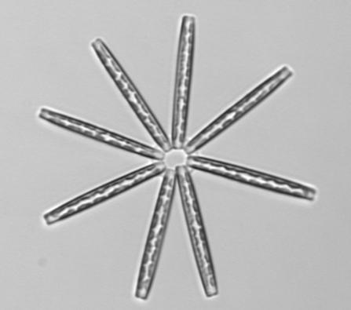
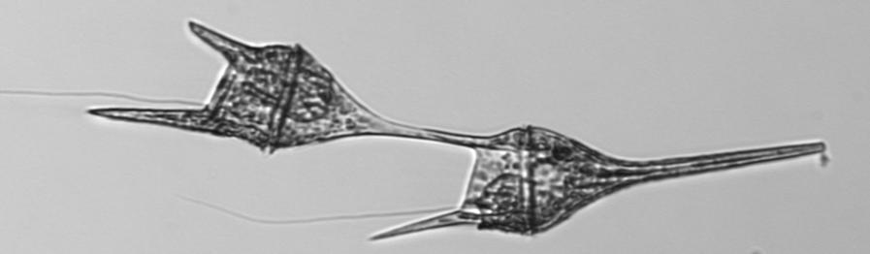
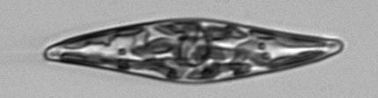
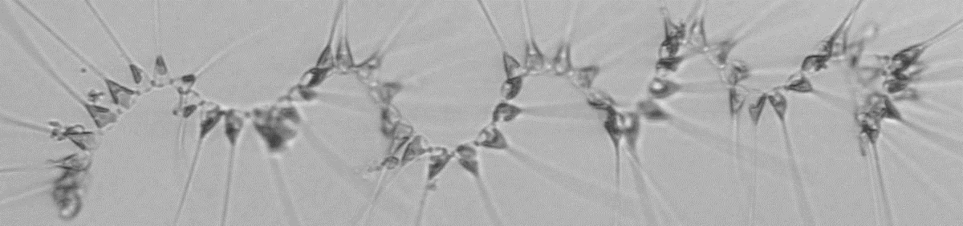
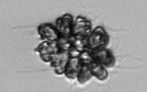
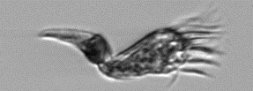
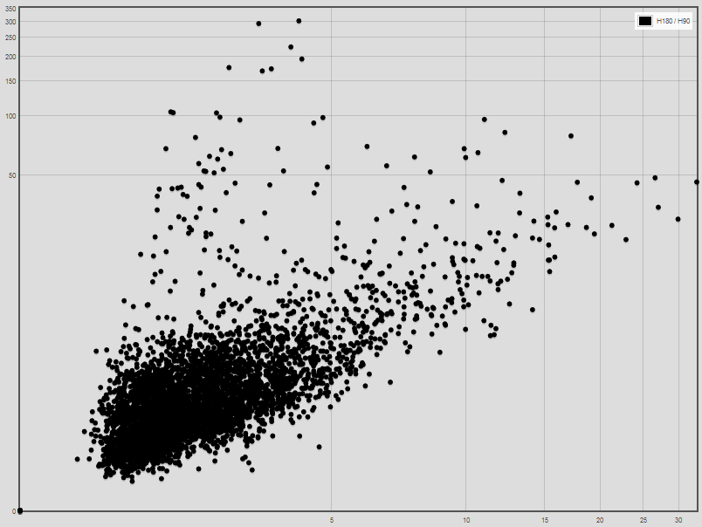
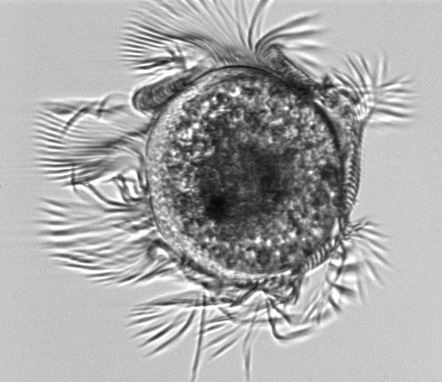
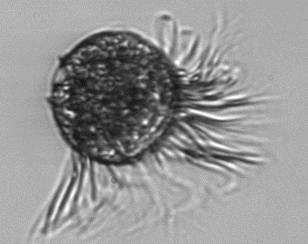
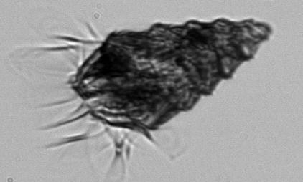
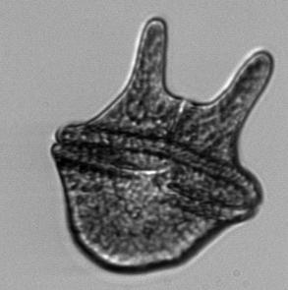
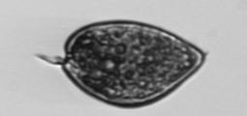
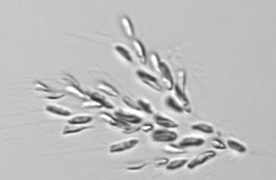
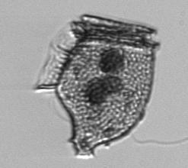
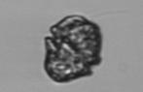
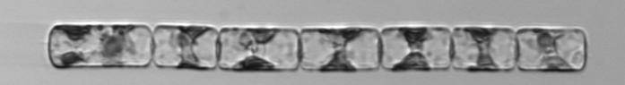
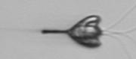
















Traditional ML approach for IFCB
Support Vector Machines
MLP neural network
Random Forest
etc.
segmentation
feature extraction
classification
Notes:
In a traditional image classification system, images are analyzed (using image processing and statistical techniques) to produce feature vectors in high-dimensional space. Classification algorithms learn to classify these feature vectors based on human-labeled training images (that have also had features extracted). Classification algorithms have a variety of strategies for modeling feature space and assigning vectors to classes.

Slide 20





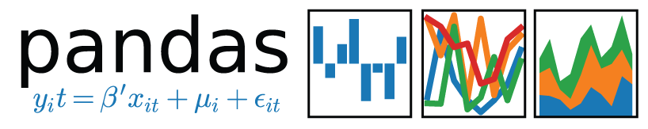
Experimental setup
Traditional machine learning
Random Forests, Support Vector Machines, and MLP Neural Networks
CNNs
Inception architecture (Google)
Transfer learning: ImageNet
NVidia GeForce 1080 GTX GPUs
Software
Training sets
10 classes, 40k images
49 classes, 156k images
80/10/10 split between training, validation, and test sets
“Naive” approach to traditional ML
Use of “black box” algorithms (e.g., scikit-learn’s simple APIs)
Little tuning
Evaluation
Overall accuracy (not used)
Confusion matrix
Precision, recall, and F1 scores
Compare CNN transfer learning to CNN full training

Slide 21


Precision, Recall, and F1 Score
Per-class metrics
Precision: of the examples identified as the class, what proportion were correct
Recall: of all the examples truly belonging to the class, what proportion were identified as that class
F1 score: harmonic mean of precision and recall; penalizes classes with low precision and/or low recall
Notes:
F1 score is a useful overall metric for performance by class. This chart shows precision and recall for each of the 49 classes sorted by F1 score, for random forests. Better-performing classes are to the left. This shows unbalanced precision and recall for many classes.

Slide 22

CNN full training performance (precision, recall, F1)
Relatively flat, top-heavy distribution
Balanced precision and recall
Near-perfect performance on top class (Corethron)
F1 = 0.996
Poorer performing classes tend to be mixes of taxa rather than individual taxa (e.g., "mix_elongated")

Slide 23

F1 scores by class for each classifier
Notes:
Results reflect a test set comprising 49 classes. CNN with full training significantly outperforms the other approaches.
Our results on CNN full training suggest that we could transfer the features we learned to different IFCB plankton classification tasks (different classes, different training sets) or even different plankton datasets.

Slide 24
Takeaways and research questions
Results: Traditional vs CNNs
Research Questions
Traditional ML techniques
Perform reasonably well
Require feature engineering (i.e., software development)
Some scale well (Random Forests) and some scale poorly (SVMs)
CNN’s
Perform significantly better than traditional ML techniques
Do not require feature engineering
Require GPUs and large amounts of RAM for large datasets
Full training is slow (days)
Transfer learning works but full training works better
What is the performance of CNN architectures other than Inception?
What happens to CNN performance when we scale to more classes (e.g., 100)?
Can we use CNN’s to make effective binary classifiers for HAB species?
With transfer learning, can we use our fully-trained feature extraction layers for classifying other plankton datasets, including datasets from other instruments?
Can we embed a CNN classifier in the IFCB so that it can run in situ in real time?
How much can tuning improve the performance of any of these approaches?

Slide 25
Acknowledgements
Heidi Sosik (WHOI), co-inventor of IFCB, developed feature extraction
Tyrone Lee (WHOI), CNN programmer
Emily Peacock (WHOI), expert in taxonomic identification and producer of training labels (this represents a very large amount of work)
Nick Symmonds (WHOI), management
Yogesh Girdhar (WHOI), management, hardware support

Slide 26



IS GPU resources (near-future)
100 GB INFINBAND FABRIC
Notes:
This GPU has state of the art performance, much faster than consumer-grade GPUs

Slide 27

GPU Node – 4x Nvidia Tesla V100 NVLink
Dell C4140
4x V100 GPU SXM2
Next-Gen NVLink Connected
2x Intel Skylake 6140 (18C each)
384 GB RAM
Infiniband EDR (100Gbps)
Nvidia Tesla V100 X 4
640 Tensor Cores (2,560 total)
5120 CUDA Cores (20,480 total)
16GB HBM2 Memory
7.8 TFLOPS Double Precision (31.2 TFLOPS total)
14.5 TFLOPS Single Precision (58 TFLOPS total)
125 TFLOPs Tensor Performance (500 TFLOPS total)
Notes:
One Dell C4140 Server with the specifications above.
There will be four Tesla V100 GPUs in the server, connected via NVLink Gen 2 at 300 GB/s.
GPUs are connected via NVLink versus just PCIe (legacy systems)
Can communicate amongst themselves without CPU interaction
Faster than CPU – PCIe to PCIe communication
Also, no more Quick Path Interconnect (QPI) communication

Slide 28
Why Volta?
High Bandwidth Memory Gen 2 (HBM2)
900 GB/s Bandwidth, 95% DRAM utilization efficiency
On-board Tensor Cores
Designed to accelerate deep learning
125 Teraflops in 1 GPU
NVLink Gen 2 (300GB/s)
Over 500 HPC Applications (Gaussian, WRF, GROMACS, etc)
Volta Optimized Software
All Deep Learning Frameworks (tensorflow, mxnet, theano, etc)
Tensor RT 3 Programmable Inference Acceleration
Notes:
HBM2 - With a combination of improved raw bandwidth of 900 GB/s and higher DRAM utilization efficiency at 95%, Tesla V100 delivers 1.5X higher memory bandwidth over Pascal GPUs as measured on STREAM.
Tensor Cores - Equipped with 640 Tensor Cores, Tesla V100 delivers 125 TeraFLOPS of deep learning performance. That’s 12X Tensor FLOPS for Deep Learning Training, and 6X Tensor FLOPS for Deep Learning Inference when compared to NVIDIA Pascal™ GPUs.
NVLink Gen 2 - NVIDIA NVLink in Tesla V100 delivers 2X higher throughput compared to the previous generation. Up to eight Tesla V100 accelerators can be interconnected at up to 300 GB/s to unleash the highest application performance possible on a single server
Over 500 HPC Applications (AMBER, ANSYS Fluent, Gaussian, GROMACS, LS-DYNA, NAMD, OpenFOAM, Simula Abaqus, VASP, WRF) enabled for use on Volta
Major Deep Learning Frameworks (Tensorflow, Caffe2, MS Cognitive Toolkit, PyTorcj, Theano)
Tensor RT 3
Deliver up to 3.7x faster inference on Tesla V100 vs. Tesla P100 under 7ms real-time latency
Optimize and deploy TensorFlow models up to 18x faster compared to TensorFlow framework inference on Tesla V100
Improved productivity with easy to use Python API

Slide 29
WHOI Shared resource
WHOI’s core HPC environment has one shared GPU node
Use via SLURM job scheduler
Fair-share model; strives for equal access to resources over time
Dedicated or time-sensitive needs?
Service model: $13,630 per year plus MTDC
Purchase model: $40,890 upfront for 3 years of use

